Slide 1

Università degli Studi di Firenze
Dipartimento di Elettronica e telecomunicazioni
Iacopo Magrini, iacopo.magrini@unifi.it
Appunti del corso “Circuiti a Microonde”

Slide 2
The Modulation
The target is to link the “information” to a carrier
Amplitude
Amplitude
Baseband signal
Carrier
0
-ω
0
+ω
Amplitude
Passband signal
Frequency
-ω
0
+ω

Slide 3
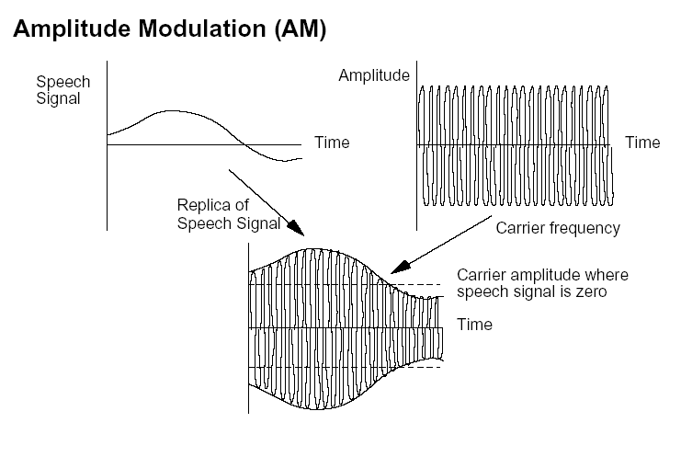
AM Modulation

Slide 4
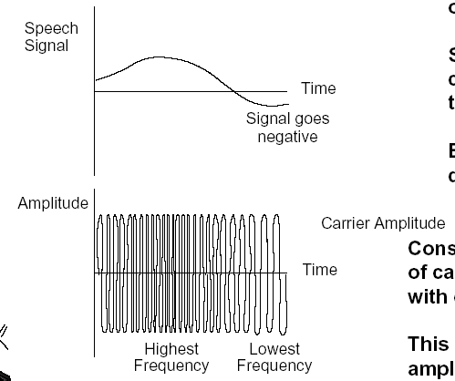
FM Modulation

Slide 5

Digital Modulation
Analog Mod.
AM
PM
FM
Digital Mod.(binary)
ASK
PSK
FSK
Baseband
Passband

Slide 6
Metrics for Digital modulations
Signal quality
Spectral efficiency
Power efficiency
BER=wrong bits/tot.bits
Spectrum width
PA requirements

Slide 7
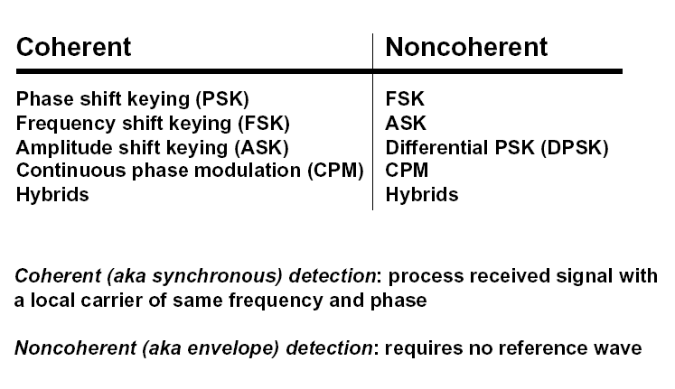
Digital modulation techniques

Slide 8
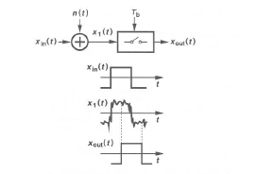
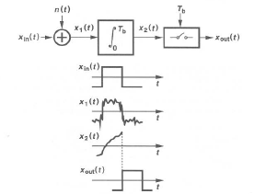
Digital Modulation Detection
(1) Sampling the peak value
(2) Sampling the peak value after integration

Slide 9
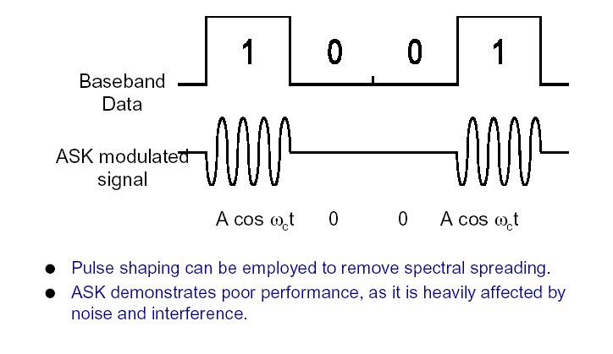
ASK Modulation

Slide 10
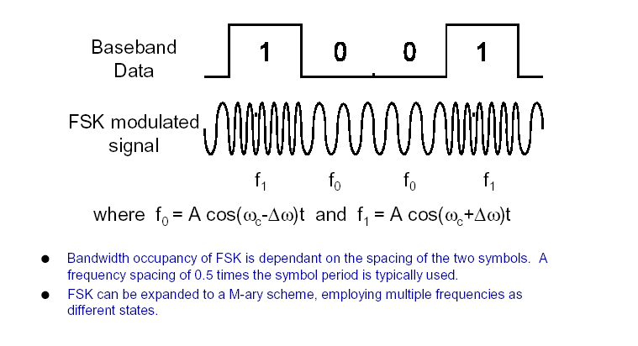
FSK Modulation

Slide 11
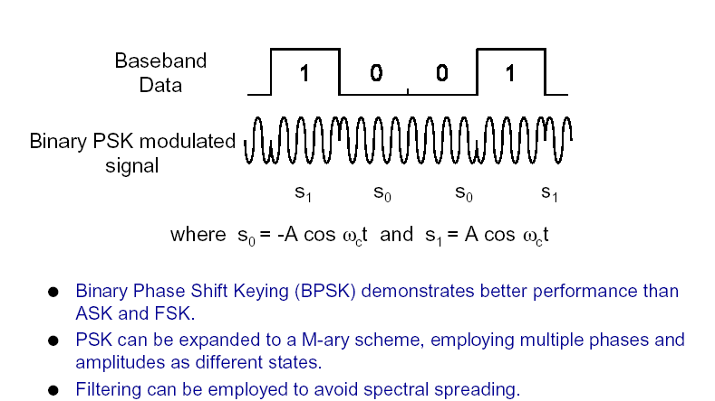
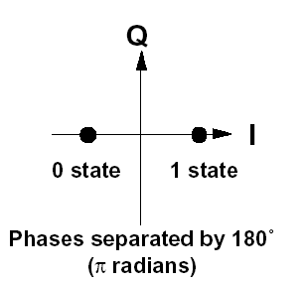
PSK Modulation

Slide 12
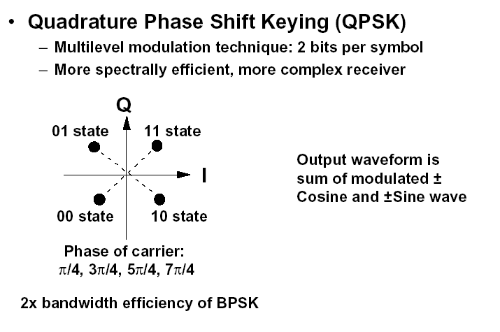
QPSK Modulation (I)
Symbol rate=
(bit rate)/(n° bit x symbol)

Slide 13
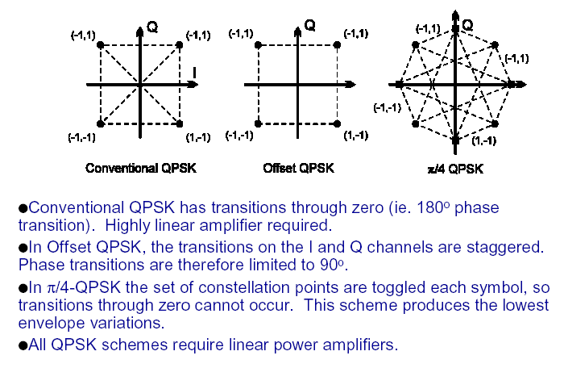
QPSK Modulation (II)
Types of QPSK

Slide 14
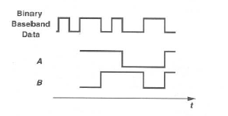
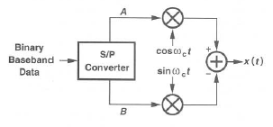
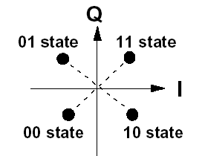
QPSK Modulation (III)
QPSK modulator

Slide 15
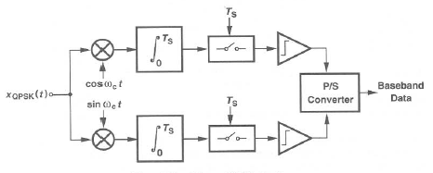
QPSK Modulation (IV)
QPSK demodulator (coherent)

Slide 16
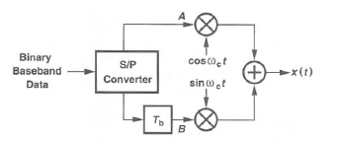
QPSK Modulation (V)
O-QPSK modulator

Slide 17
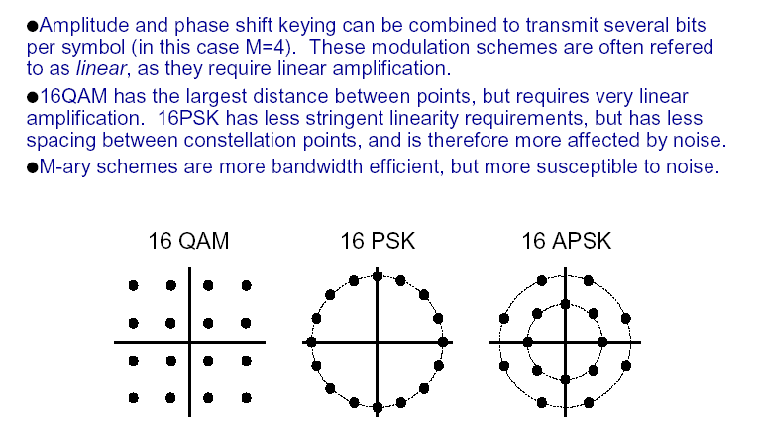
M-ary and QAM Modulations

Slide 18
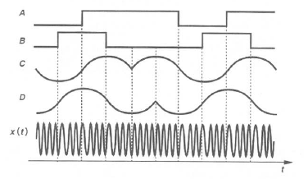
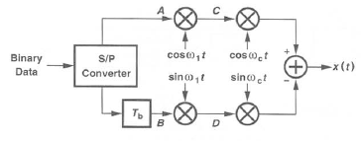
MSK Modulation
MSK modulator

Slide 19
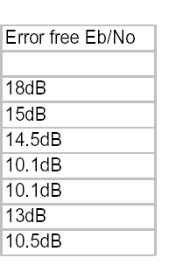
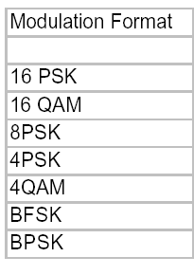
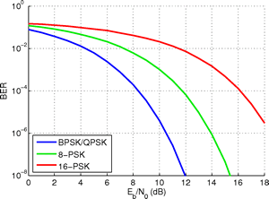
Modulations Performance

Slide 20
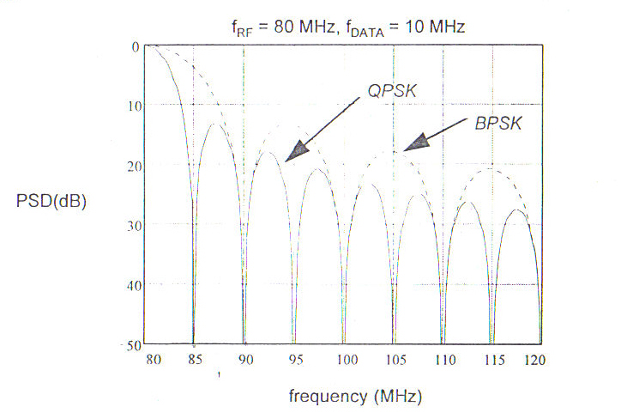
Band enhancement
First null= 1/Tsimbol
Symbol rate=
(bit rate)/(n° bit x symbol)
2 bits symbol leads to an half equivalent bit rate

Slide 21
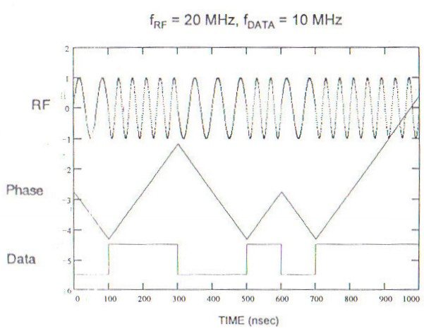

FSK Modulation (I)
K=1,0

Slide 22

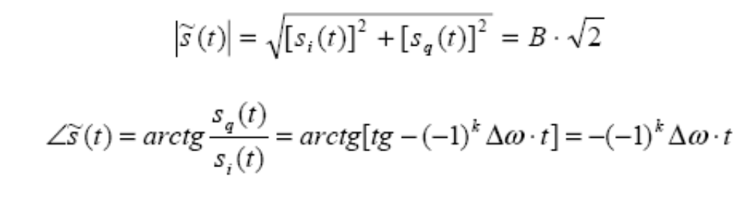
FSK Modulation (II)
Starting from the previous relation, removing the carrier and filtering
we obtain
I component
Q component
Amplitude
Phase

Slide 23
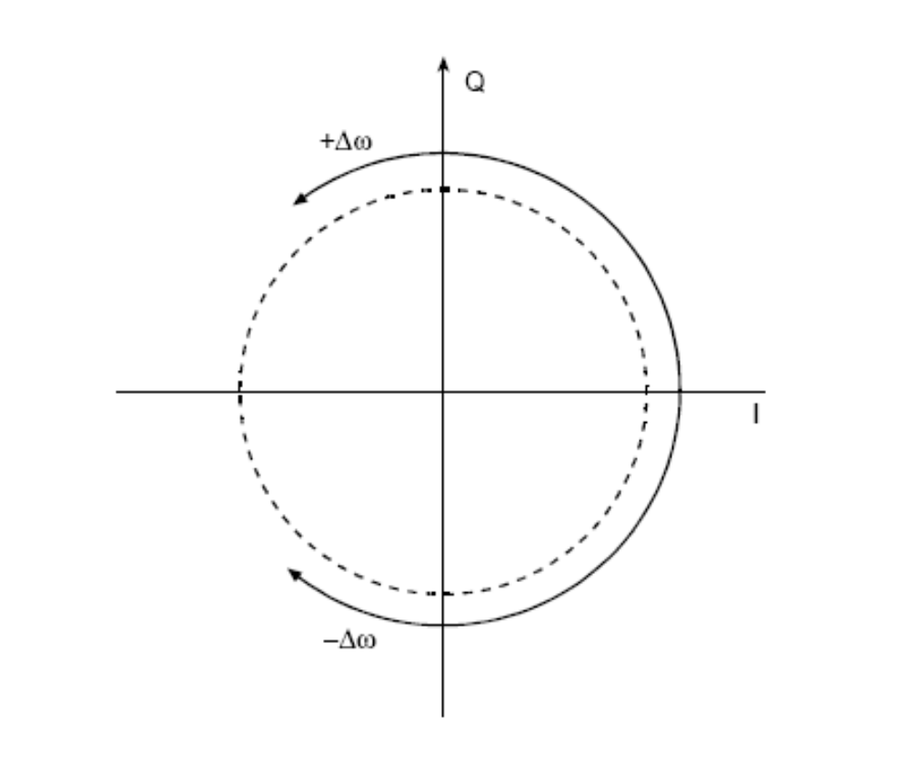

FSK Modulation (III)
It is possible to describe the baseband signal by means of a phasor
The sign of K settles the rotation

Slide 24
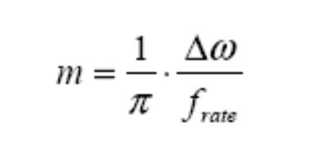
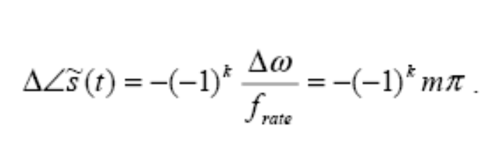

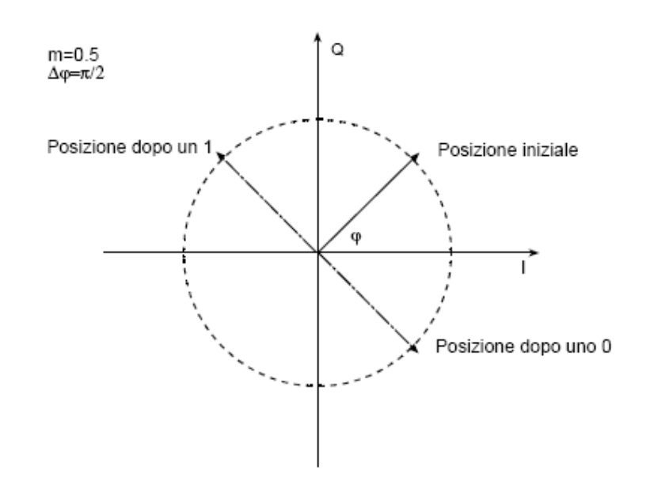
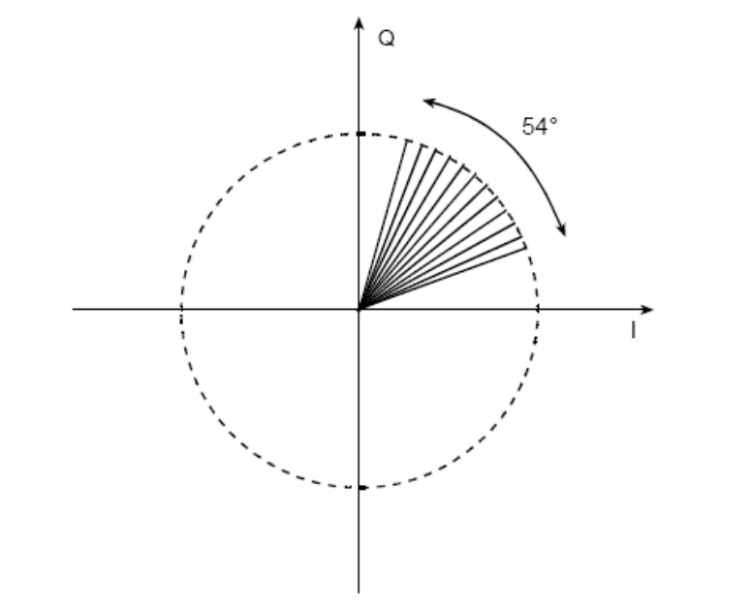
FSK Modulation (IV)
Defining the modulation index and remembering the relation between symbol time and rate frequency we can derive the phase increment during the symbol time
M=0.5
M=0.3

Slide 25
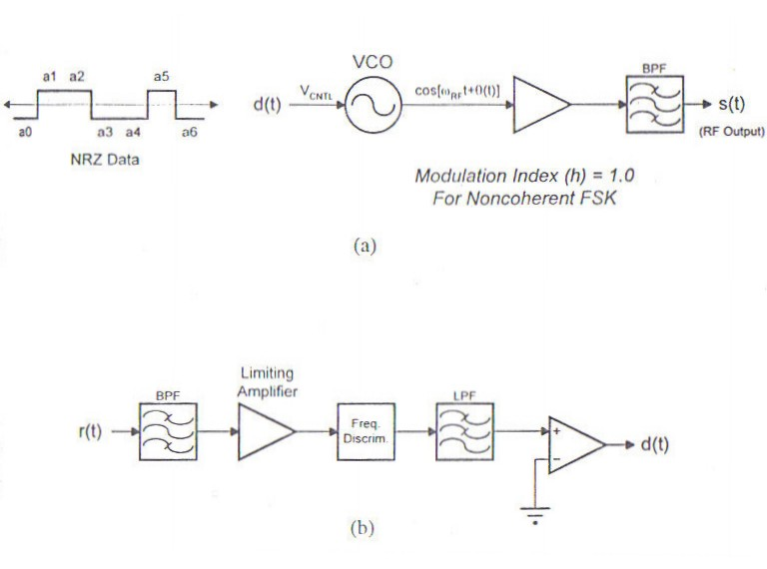
FSK Modulation (V)
Noncoherent TX path (Top) and RX path (bottom) for Binary FSK modulation

Slide 26
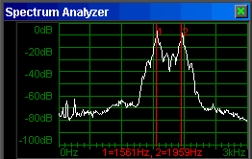
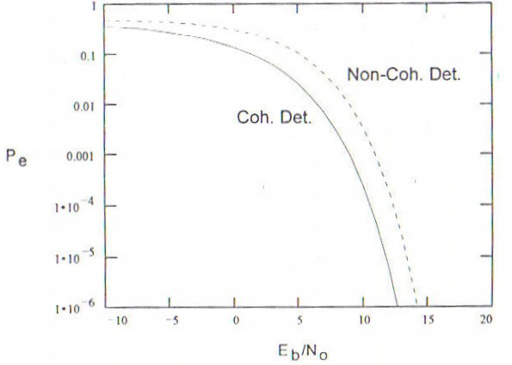
FSK Modulation (VI)
FSK spectrum for low modulation index
Probability error Vs Eb/No

Slide 27
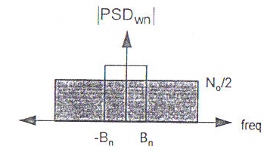




FSK Modulation (VII)
It is possible to derive the relation between Eb/No and SNR

